Slide 1
INSTITUTE OF TECHNOLOGY & MANAGEMENT
B.Tech. , 2nd Year, 4th Semester
Computer Science Engineering
Topic :- Price Notify
Presented By:-
Mukul Tarsoliya(0905CS201107)
Neelesh Kushwah(0905CS201112)
Nikhil Shrivastava(0905CS201116)
Nitin Gangwani(0905CS201118)
Pranjal Sharma(0905CS201125)
Priyanshika Singh(0905CS201131)
Rahul Batham(0905CS201134)
Rahul Singh Bhadauriya(0905CS201138)
Rishika Sharma(0905CS201141)
Ritika Jain(0905CS201142)
Sakshi Galgale(0905CS201151)

Slide 2
Table of Content
General introduction
Modules Used
Working
Functional description
Screenshots of project
Future ideas

Slide 3
What is our project?
Python does wonderful things. And, there is hardly anything this beautiful language can’t do. Bundles of libraries have boosted this language to outshine every other when it comes to data analysis, web scraping, or task automation.
Our topic is an automatic price checker that will give you an email alert if there is a price drop.

Slide 4
Modules included:-
Beautiful Soup from bs4
Request
Flask
Sqlite
smtplib

Slide 5
Continue…

Slide 6
Beautiful Soup from bs4
Beautiful Soup is a Python library that is used for web scraping purposes to pull the data out of HTML and XML files.
Beautiful Soup is a great tool for extracting very specific information from large unstructured raw Data, and also it is very fast and handy to use.
In project:
Using request and beautiful Soup module we created a soup object which parses the webpage for the product name and price.

Slide 7
HTML
HTML is an acronym which stands for Hyper Text Markup Language which is used for creating web pages and web applications.
HTML consists of a series of elements, tell the browser how to display the content, label pieces of content such as "this is a heading", "this is a paragraph", "this is a link", etc.
In project :
Using HTML we have taken input of url and email from the user on web GUI.

Slide 8
Flask
Flask is a web framework used in creating web applications.
Flask is a micro-framework which means it is a light framework. It also is a more flexible framework, hence we can make more modifications to it.
In project :
Using class flask we have taken input of url and email from the user on web GUI. It is used for rendering the pages of the site.

Slide 9
SQLite
SQLite does not require a separate server process or system to operate (serverless).
It is a database, which is zero-configured, which means like other databases you do not need to configure it in your system.
In project :
Using sqlite module connection is established with database and the product name, price , url and mail id gets stored in the database.

Slide 10
Smtplib
Mail servers and other message transfer agents use SMTP to send and receive mail messages. The smtplib is a Python library for sending emails using the Simple Mail Transfer Protocol (SMTP).
In project :
After every 6 hours, task scheduler will do a rountine check for price drop. If price will get dropped it
Will notify you on your email using smtlib module.

Slide 11
Working of project:-

Slide 12
Functional Description:-
price_scrapper (url):-
Extracts the product price and name from the url.
insert_product(name,price,url,mail):-
Insert the product details in the database.
get_product():-
Extracts the product details from the database to display it on the front page of web GUI.
mail_alert(mail):-
It send mail alert to the mail id when price falls down.

Slide 13
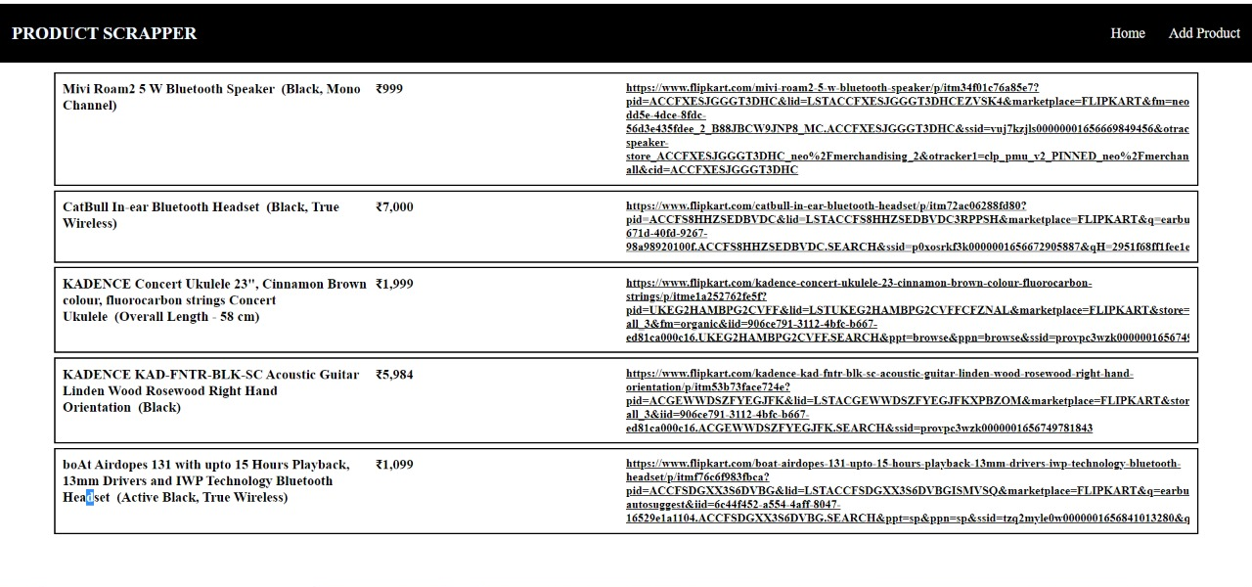
Home page

Slide 14
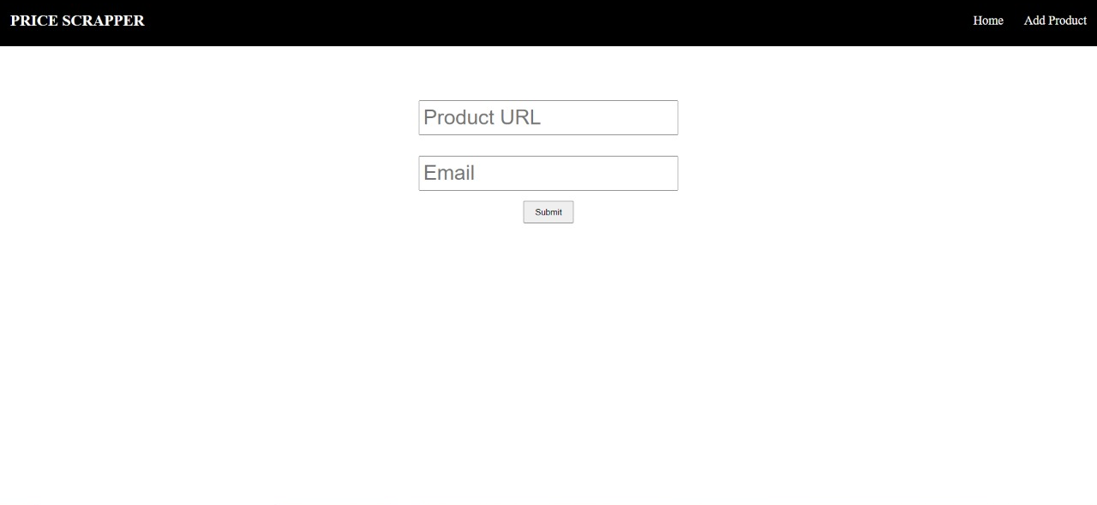
Form Page

Slide 15
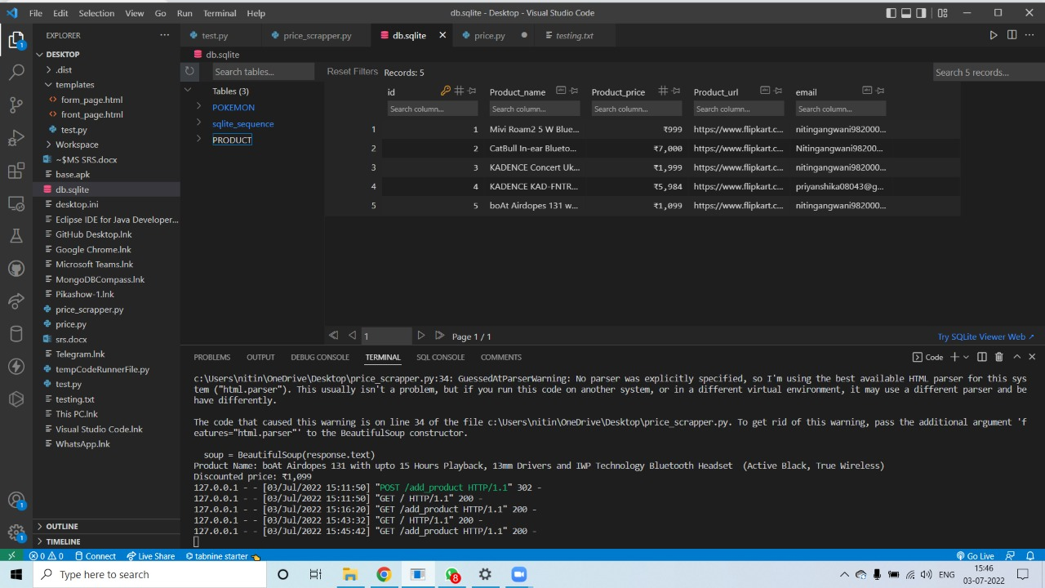
Sql table(database)

Slide 16
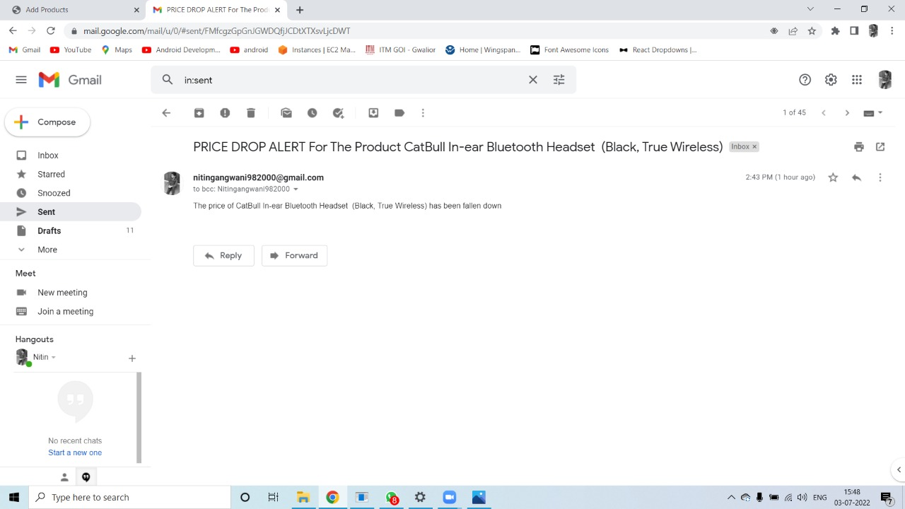
Email alert

Slide 17
Future Ideas
Login portal and registration form can be added to show a particular user only the data or products which he/she add further.
The app can be made such that it can accept various site url for the email alerts.
Web GUI could be more better.

Slide 18


